Slide 1
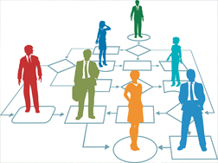
Use Case Demo
Automating Data Migration of University data
Smarter Process Practice
Prolifics
Client Confidential | Copyright © 2018 Prolifics
Notes:
What do we want the title for the deck to be?

Slide 2
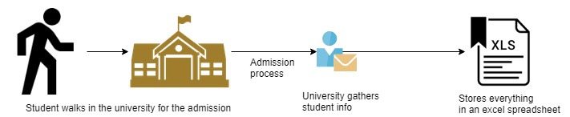
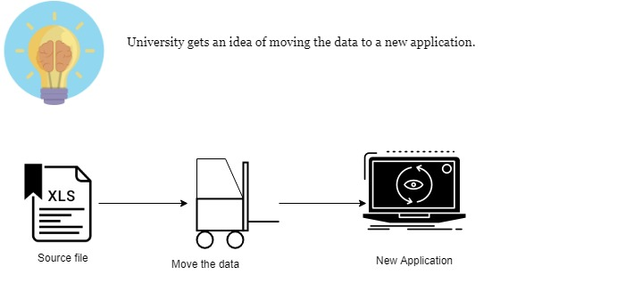
Overview
Modernization

Slide 3
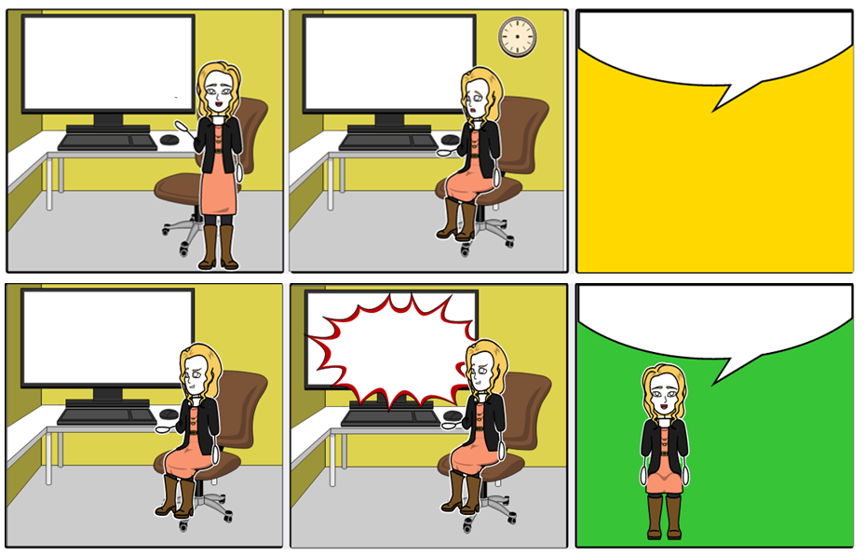

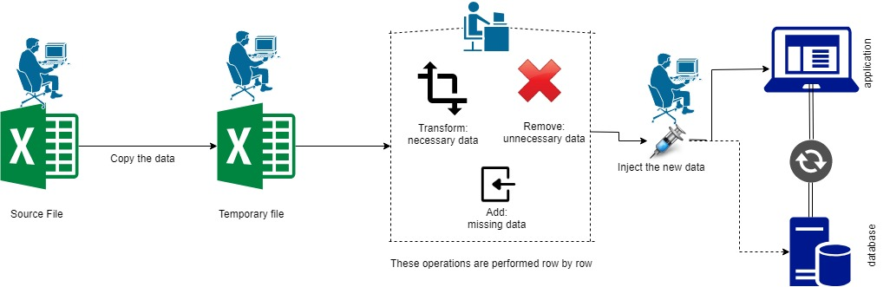
Current Scenario of data migration
Oh!!!!! I need to copy all the data to a temporary file, perform manipulations, and inject the new data into the application
Takes multiple man hours
Repetitive and is Robotic in nature
Copy all details
Transform data
Add & remove data
Inject it to the new app.
Can I do it in a better way !!
%3CmxGraphModel%3E%3Croot%3E%3CmxCell%20id%3D%220%22%2F%3E%3CmxCell%20id%3D%221%22%20parent%3D%220%22%2F%3E%3CmxCell%20id%3D%222%22%20value%3D%22%22%20style%3D%22endArrow%3Dnone%3Bdashed%3D1%3Bhtml%3D1%3B%22%20edge%3D%221%22%20parent%3D%221%22%3E%3CmxGeometry%20width%3D%2250%22%20height%3D%2250%22%20relative%3D%221%22%20as%3D%22geometry%22%3E%3CmxPoint%20x%3D%221038%22%20y%3D%22480%22%20as%3D%22sourcePoint%22%2F%3E%3CmxPoint%20x%3D%221278%22%20y%3D%22480%22%20as%3D%22targetPoint%22%2F%3E%3C%2FmxGeometry%3E%3C%2FmxCell%3E%3C%2Froot%3E%3C%2FmxGraphModel%3E
There you go !!!!! All templates are uploaded in minutes ☺
Let me ask my BOT buddy to check and create journal entries for this month ☺
WORK is FUN !!!!
BOT IN Action
January 31, 2019
Confidential | Copyright © 2017 Prolifics

Slide 4
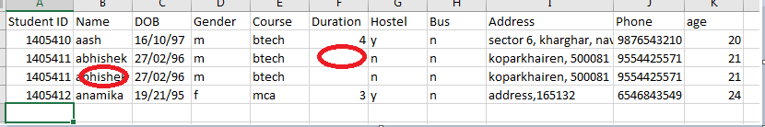

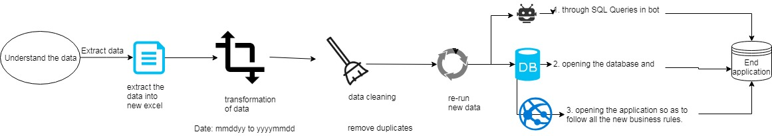
Detailed Use Case Overview
Figure 1:Here we've duplicate data needs to be de-duplicated and missing data like duration needs to be populated
1
2
3
4
5
6
January 31, 2019
Confidential | Copyright © 2017 Prolifics

Slide 5
Internal Transfer JE – Reimagined Process Using BOT
Oh!!!!! I need to review all Workbooks, validate information and create JE template
Takes multiple man hours
Repetitive and is Robotic in nature
Download workbooks
Validate information
Populate Template
Upload file
Can I do it in a better way !!
There you go !!!!! Everything done in minutes ☺
Let me ask my BOT buddy to manipulate the data and inject it.☺
WORK is FUN !!!!
BOT IN Action
January 31, 2019
Confidential | Copyright © 2017 Prolifics

Slide 6
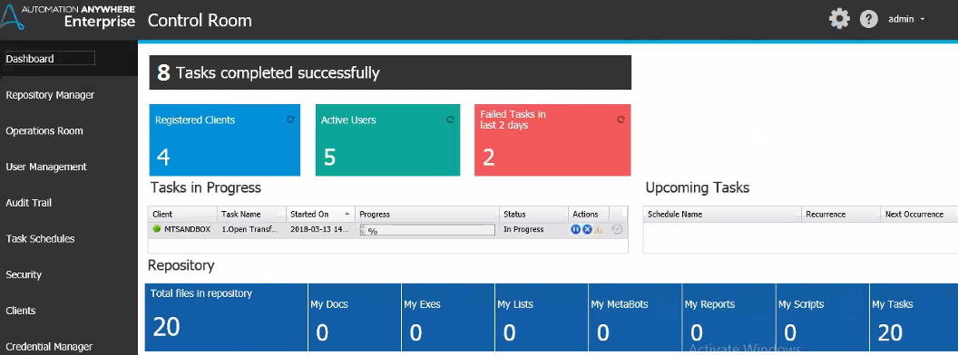
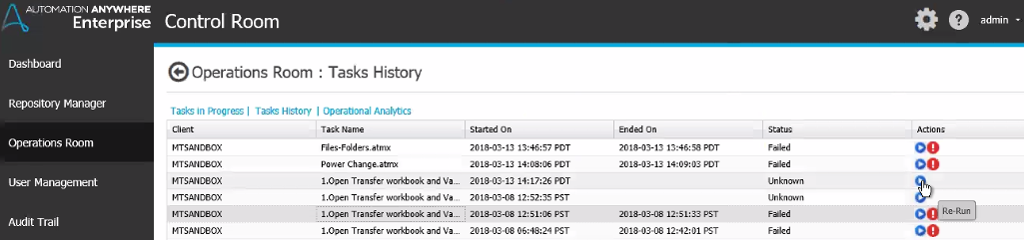


RPA-Other Features
Real-time operational insights
Centralized analytics dashboard
User Entitlements
Task History and BOT Status
Credential Vault and Access Control
Auditing and Schedulers

